Slide 1
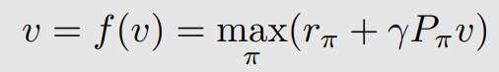
MC：蒙特卡洛学习
最优Belman方程
最优Belman方程
求解v：迭代更新
假设：环境模型未知
方法：学习随机变量的期望值 - 采样数据，平均值估计
算法：
基础MC算法 - 效率低，没法实际用，理解核心idea
MC Exploring Starts
MC ε -greedy
利用数据！
model-free RL Algorithm

Slide 2
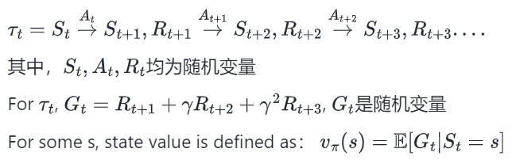
Monte Carlo Learning
复习：Belman方程BE与Belman最优方程BOE

Slide 3
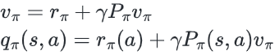
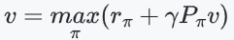
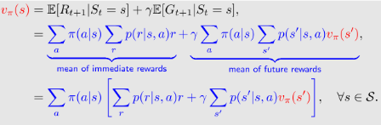
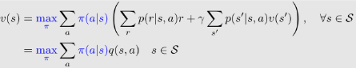
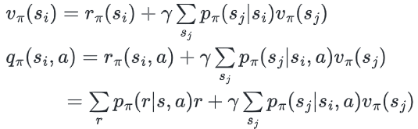
复习下 BE和BOE
BE
BOE
矩阵向量形式
元素形式

Slide 4
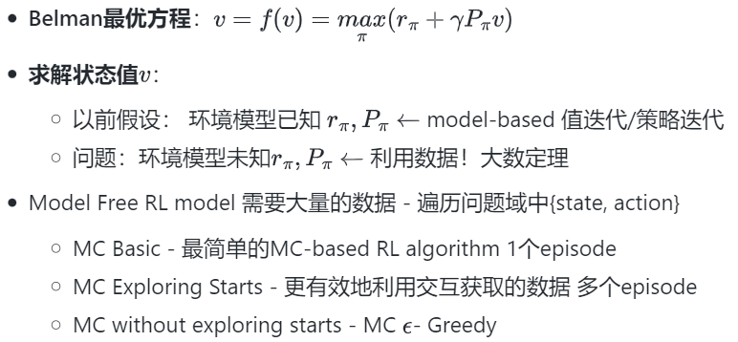
本节目标
总结下概念
Exploiting and Exploration 利用/探索
占用度量

Slide 5
目录
1. 例子：无环境模型下的随机变量的取值-sampling
2. MC Basic 算法
3. MC Exploring Starts 算法
4. MC without Exploring Starts - MC ε- Greedy算法

Slide 6
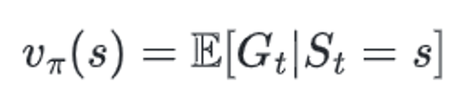
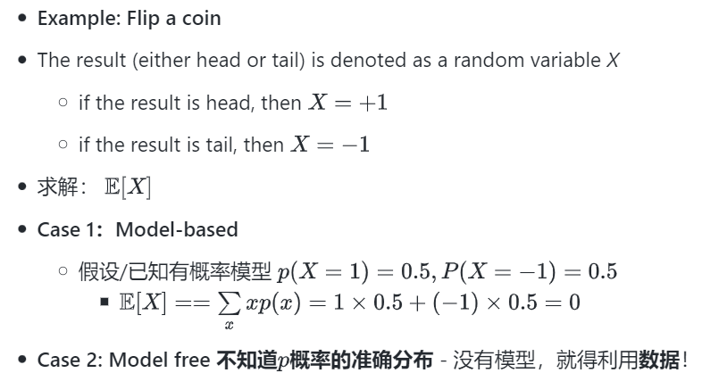
看个例子：理解Monte Carlo预测

Slide 7
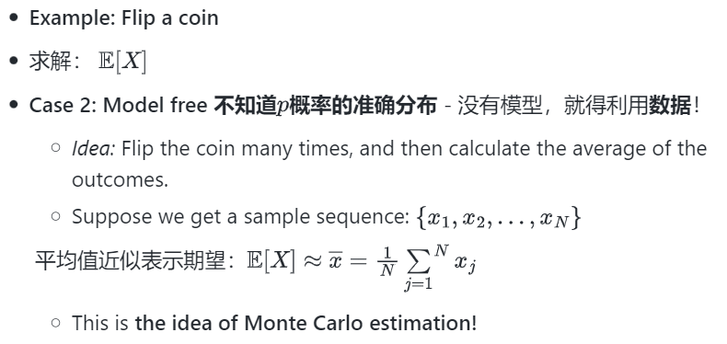
看个例子：理解Monte Carlo预测

Slide 8
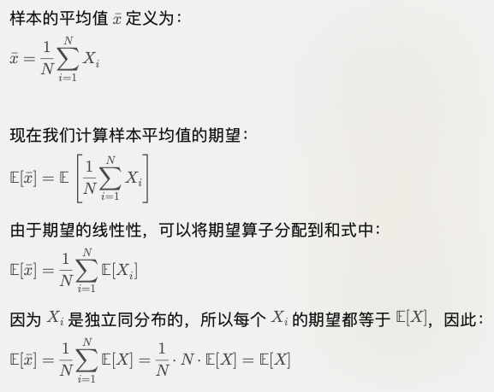
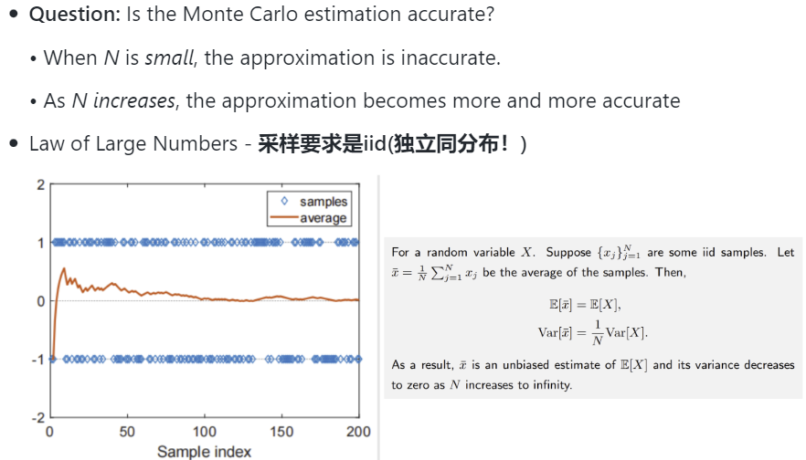
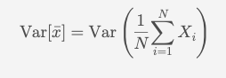
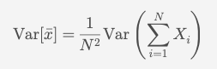
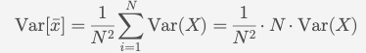
看个例子：理解Monte Carlo预测

Slide 9
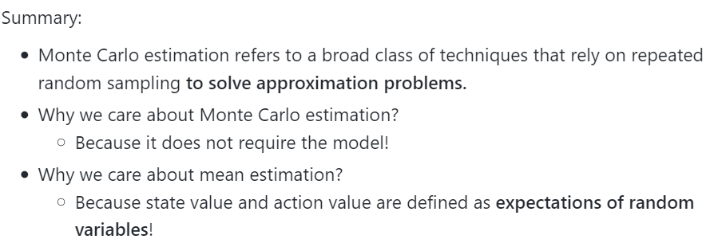
Monte Carlo estimation

Slide 10
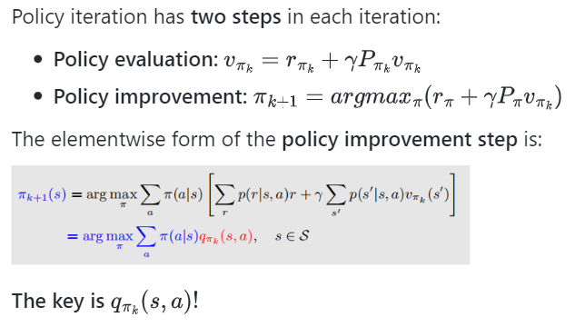
2. Convert policy iteration to be model-free
算法关键是： to understand how to convert the policy iteration algorithm to be model-free.
基础：
policy iteration
Monte Carlo mean estimation

Slide 11
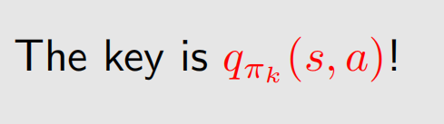
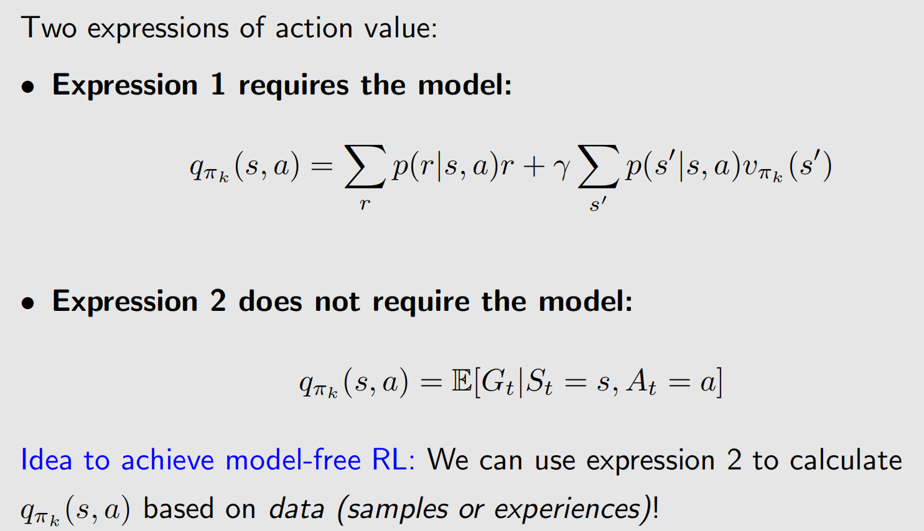
2. Convert policy iteration to be model-free

Slide 12
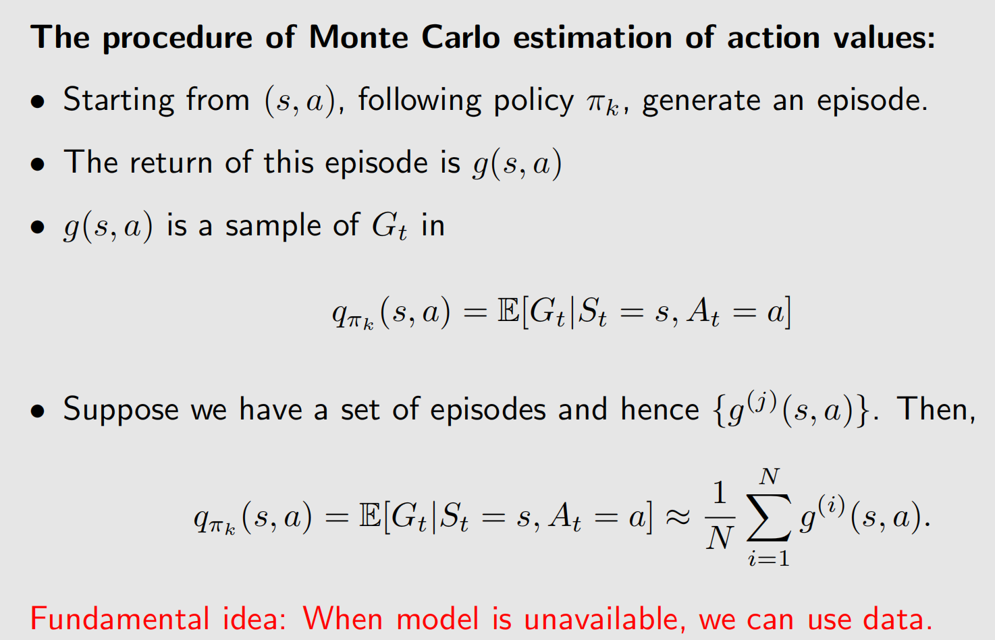
2. Convert policy iteration to be model-free

Slide 13
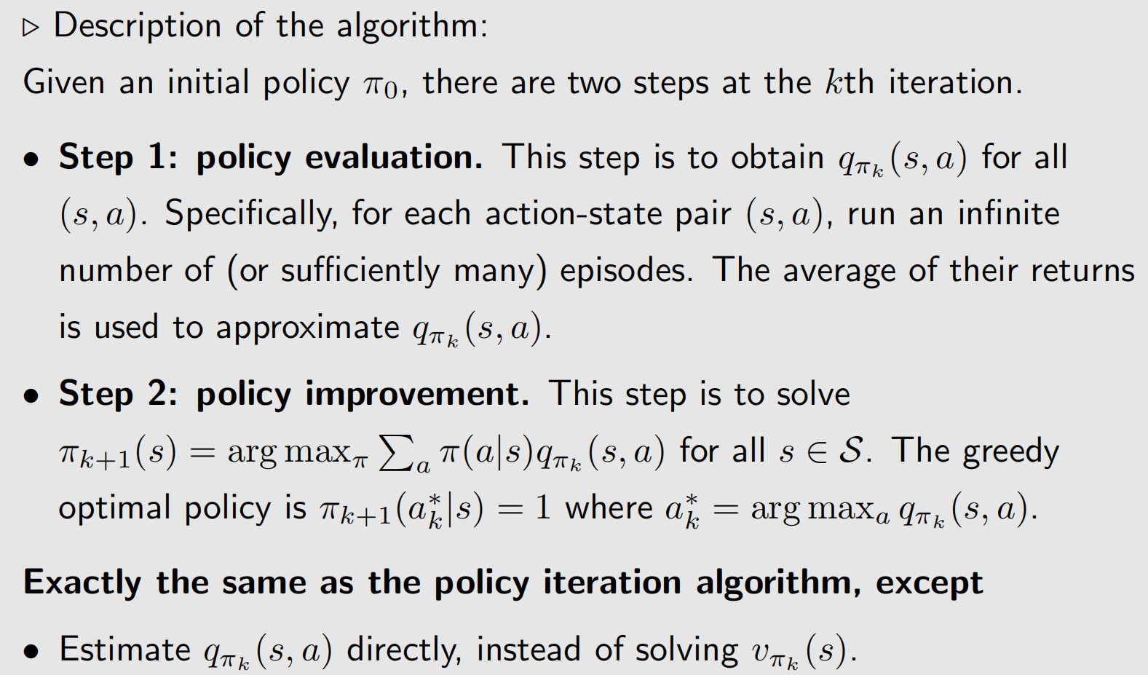
The MC Basic Algorithm

Slide 14
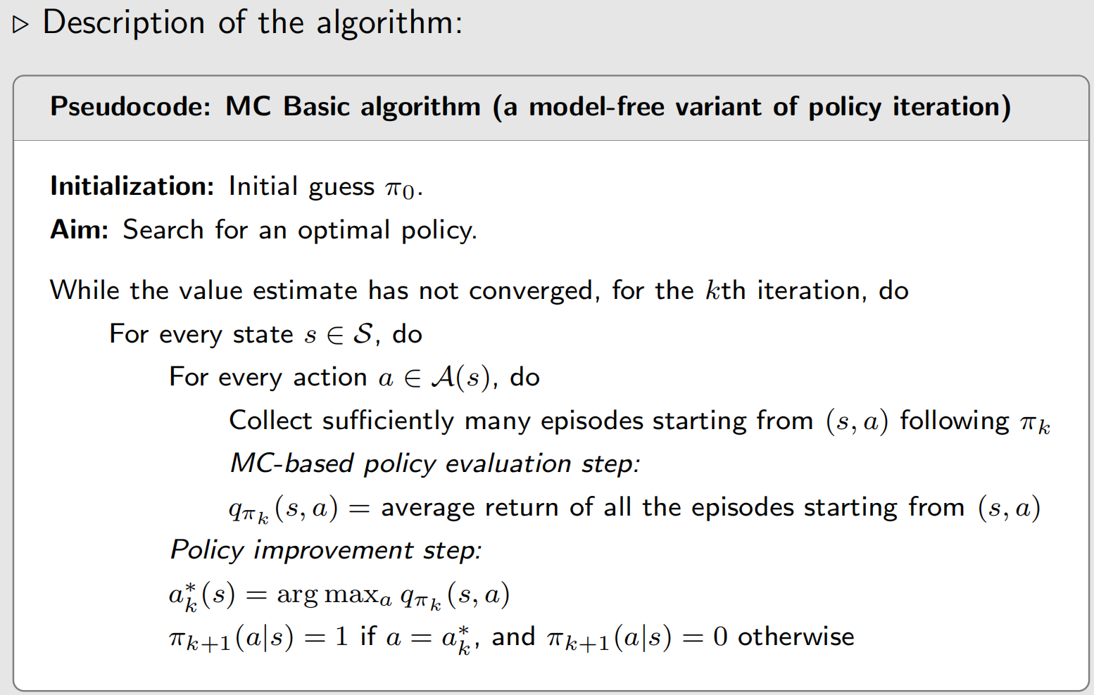
The MC Basic Algorithm

Slide 15
The MC Basic Algorithm
MC Basic is a variant of the policy iteration algorithm.
The model-free algorithms are built up based on model-based ones. It is, therefore, necessary to understand model-based algorithms first before studying model-free algorithms.
MC Basic is useful to reveal the core idea of MC-based model-free RL, but not practical due to low efficiency.
Why does MC Basic estimate action values instead of state values?
That is because state values cannot be used to improve policies directly. When models are not available, we should directly estimate action values.
Since policy iteration is convergent, the convergence of MC Basic is also guaranteed to be convergent given sufficient episodes.

Slide 16
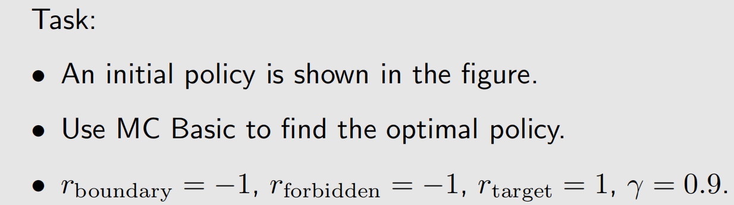
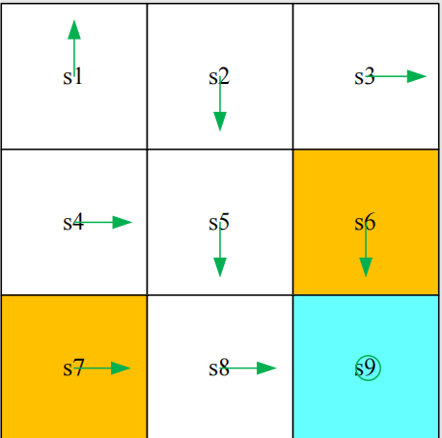
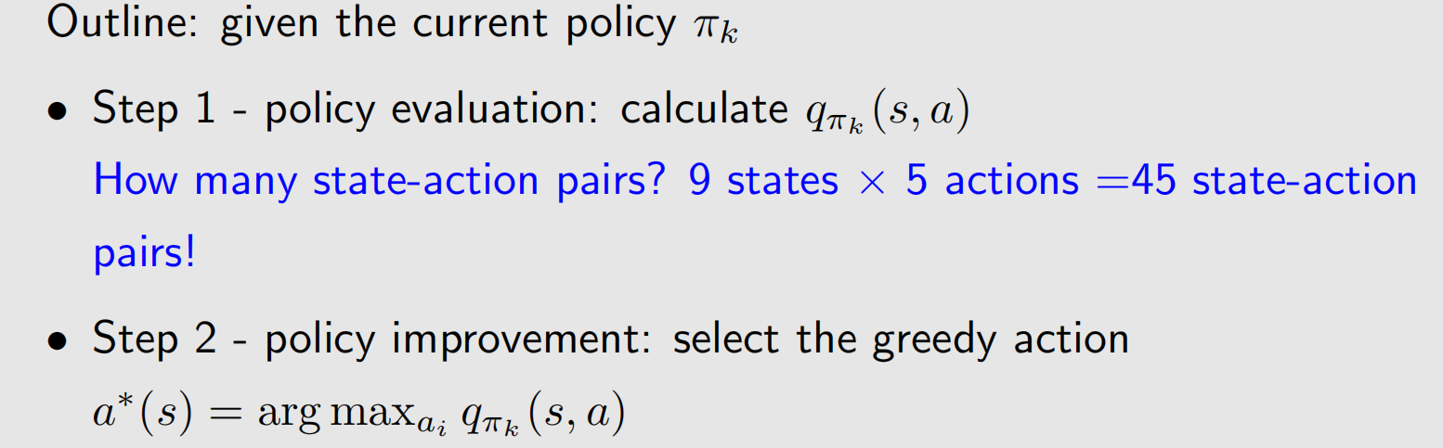
MC Basic Algorithm - Illustrative example 1: step by step

Slide 17
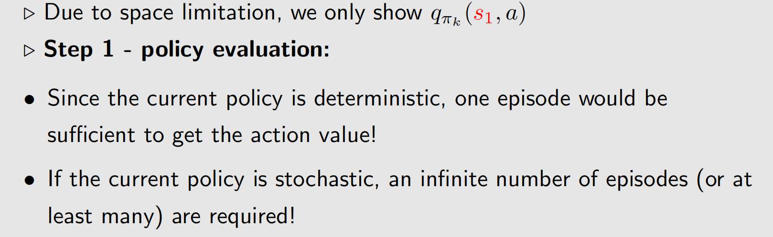
MC Basic Algorithm - Illustrative example 1: step by step

Slide 18
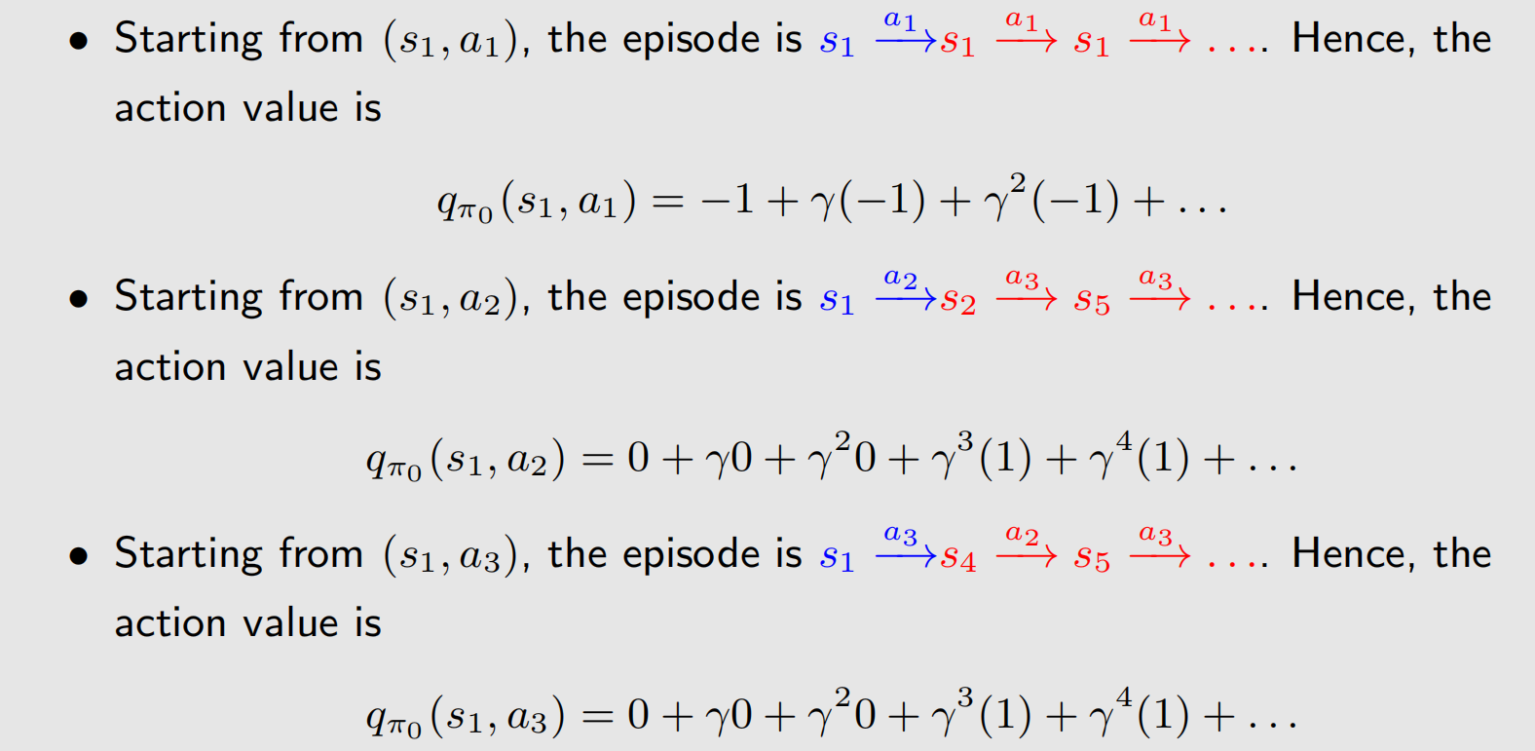
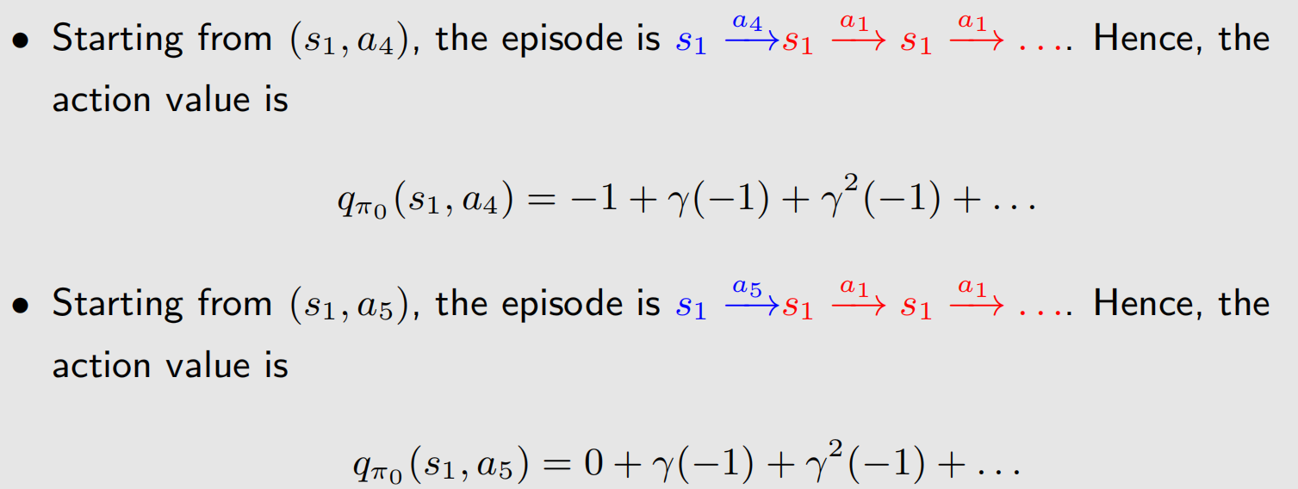
MC Basic Algorithm - Illustrative example 1: step by step

Slide 19
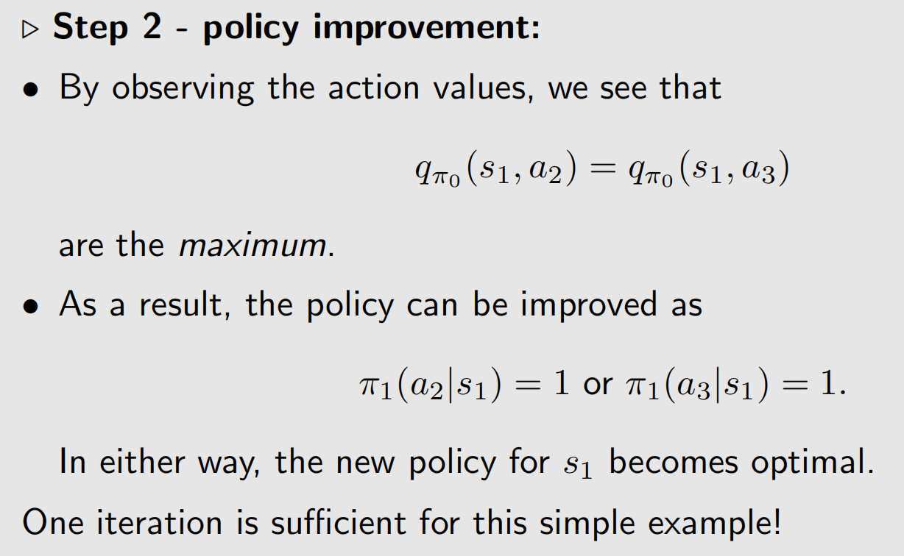
MC Basic Algorithm - Illustrative example 1: step by step

Slide 20
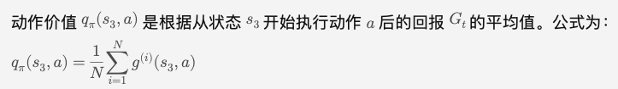
MC Basic Algorithm - Illustrative example 1: step by step
Exercise: now update the policy for s3 using MC Basic!
从 (s3, a1) 开始的episode ：-1+$γ\left(−1\right)+ γ^{2}\left(−1\right)+…$
从 (s3, a4) 开始的episode ：-1+$γ\left(−1\right)+ γ^{2}\left(−1\right)+…$
从 (s3, a3) 开始的episode ：0+$γ\left(0\right)+ γ^{2}\left(0\right)+γ^{3}\left(1\right)…$
从 (s3, a2) 开始的episode ：-1+$γ\left(0\right)+ γ^{2}\left(1\right)+γ^{3}\left(1\right)…$
从 (s3, a5) 开始的episode ：0 +$γ\left(−1\right)+ γ^{2}\left(−1\right)+γ^{3}\left(−11\right)…$

Slide 21
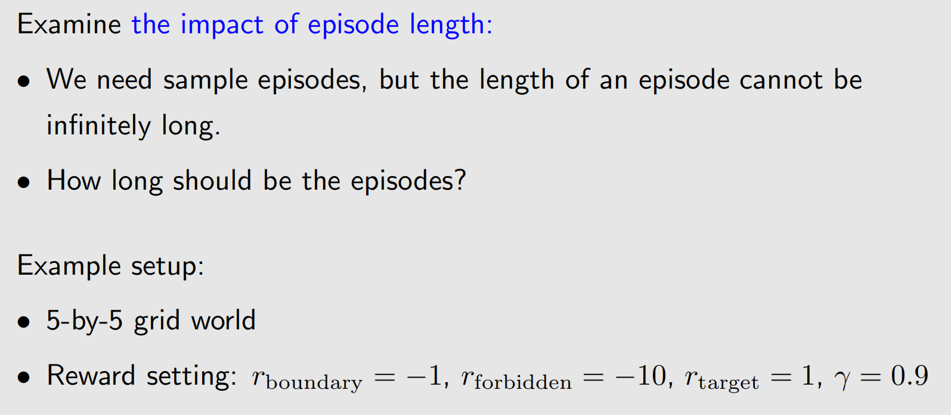
MC Basic Algorithm - Illustrative example 2: Episode Length

Slide 22
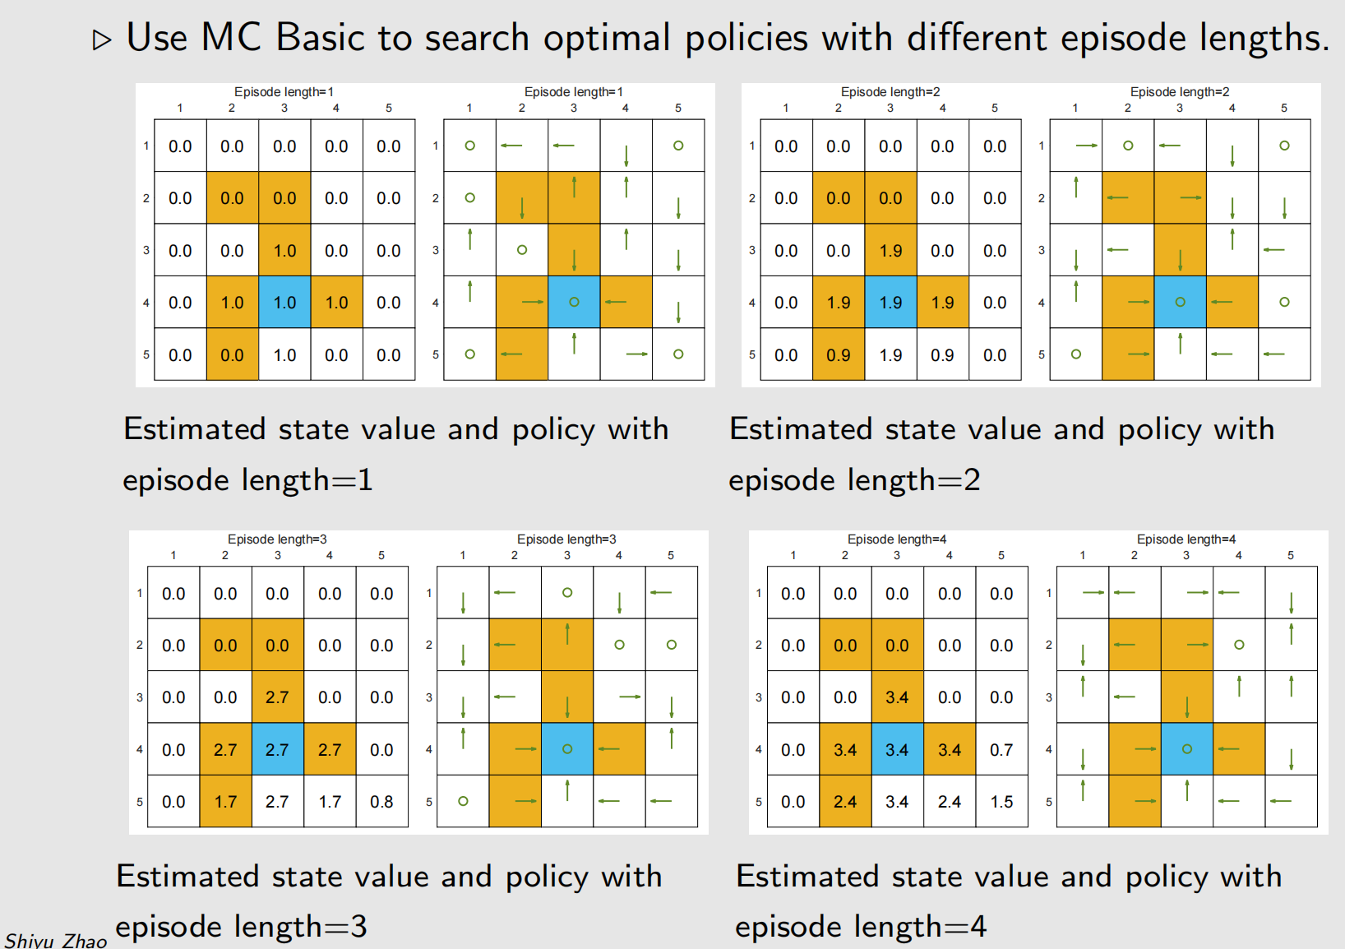
MC Basic Algorithm - Illustrative example 2: Episode Length

Slide 23
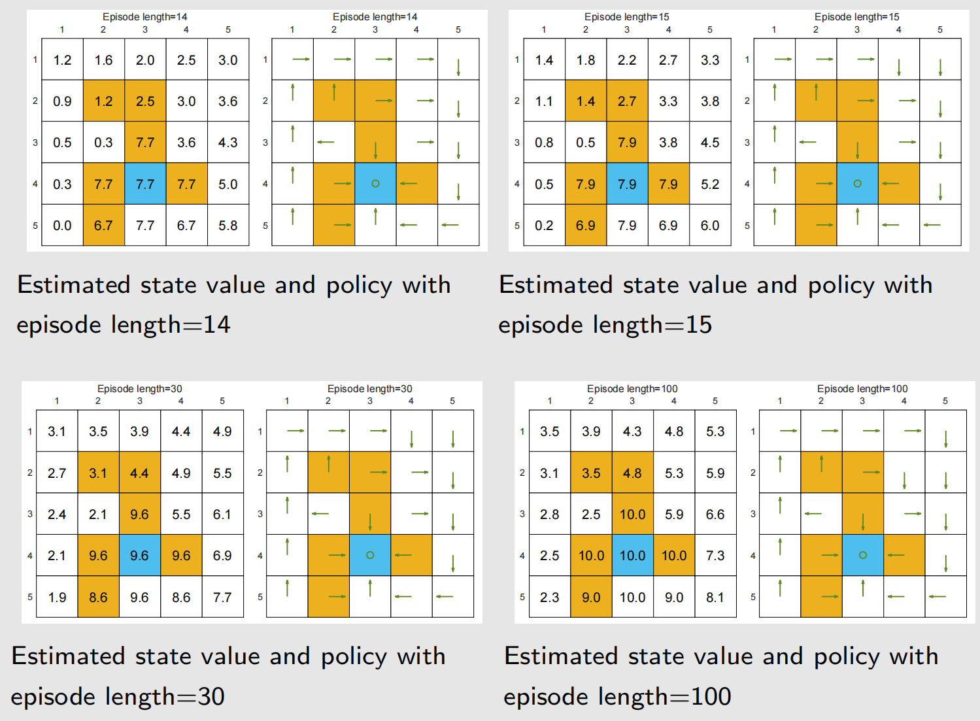
MC Basic Algorithm - Illustrative example 2: Episode Length

Slide 24
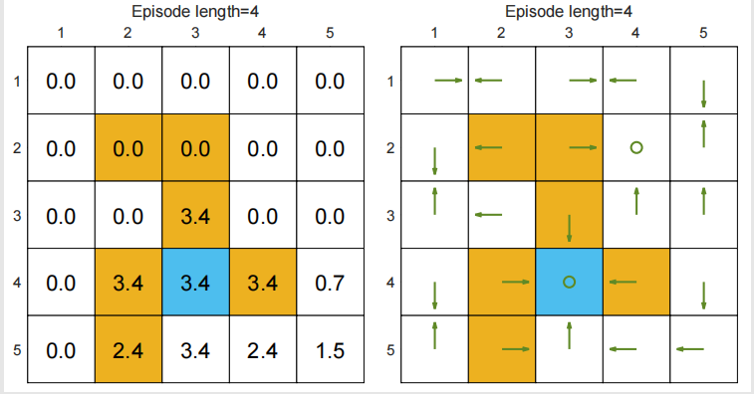
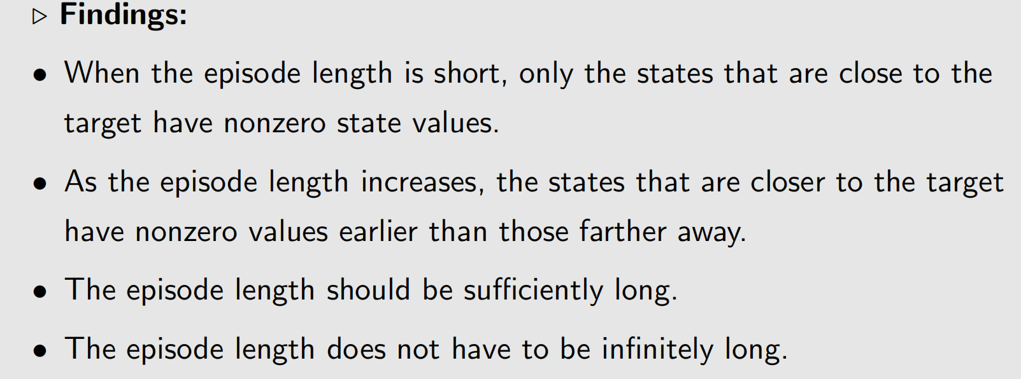
MC Basic Algorithm - Illustrative example 2: Episode Length

Slide 25
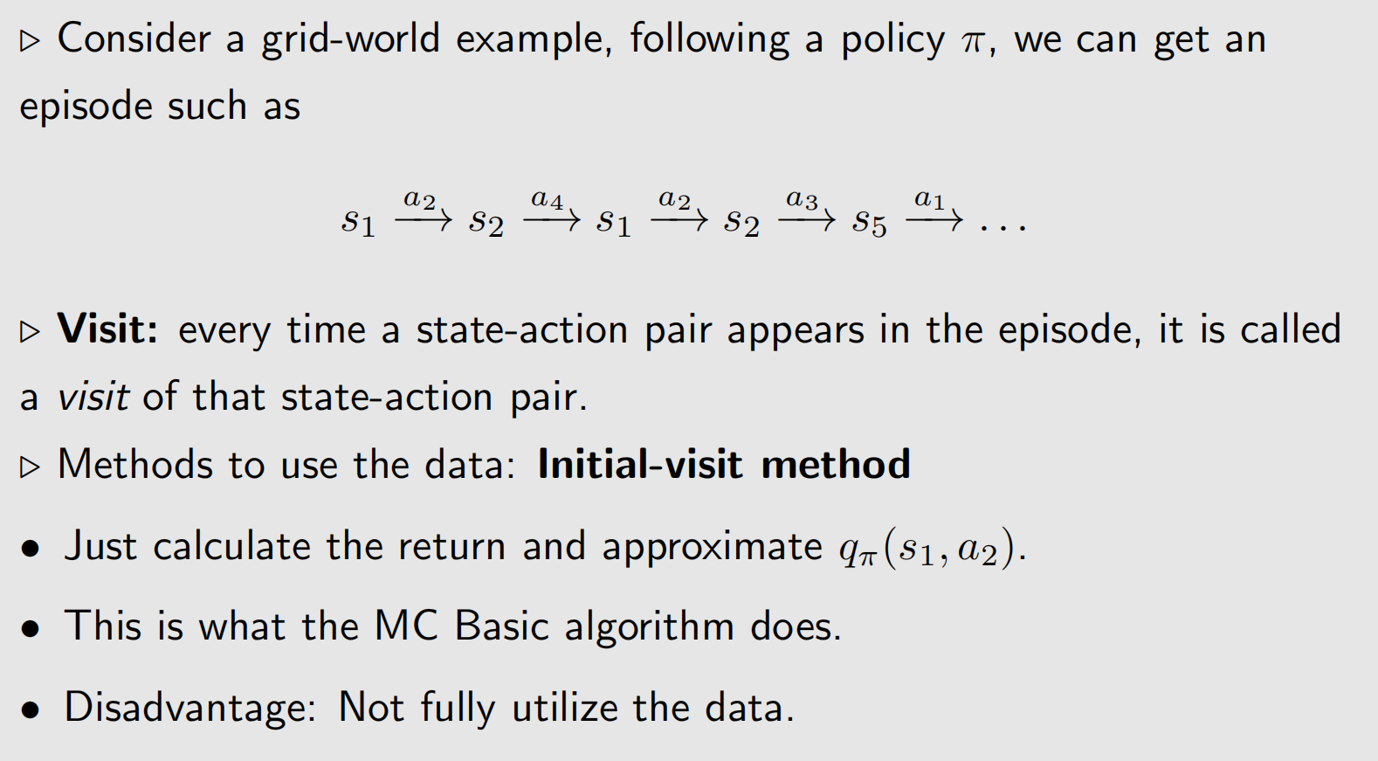
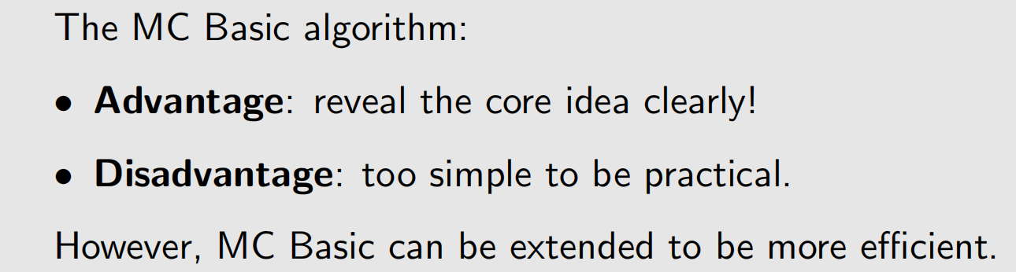
3. Use data more efficiently –MC Exploring Starts

Slide 26
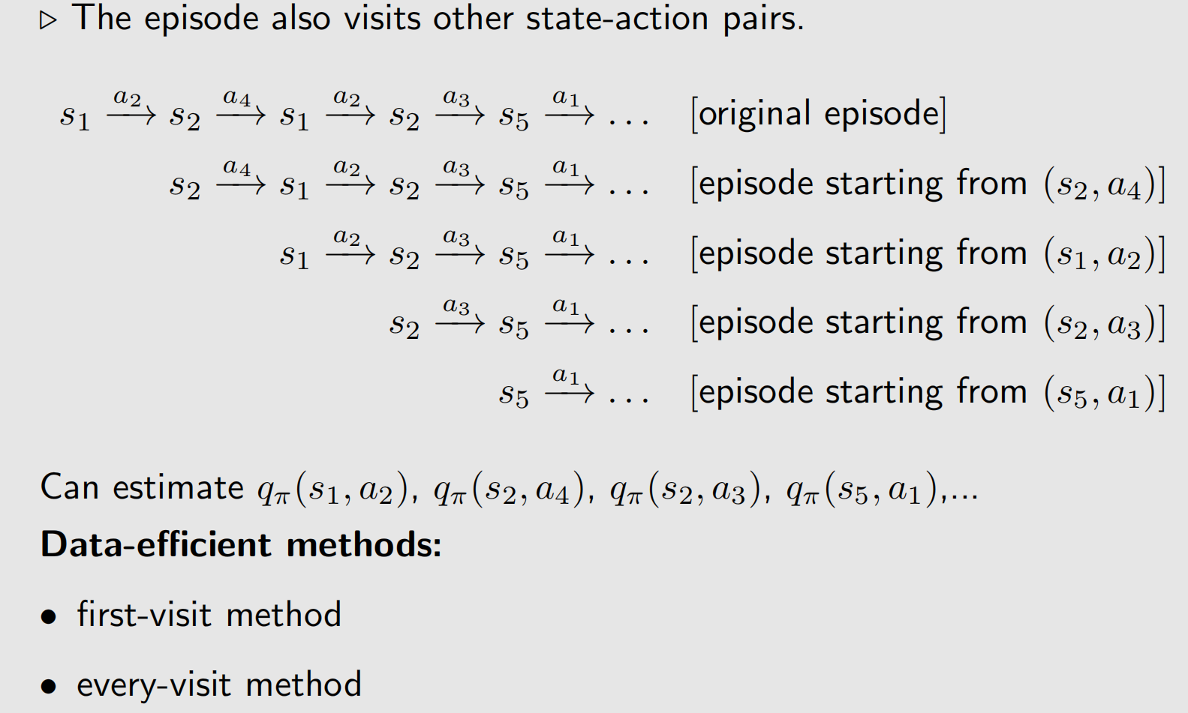
3. Use data more efficiently –MC Exploring Starts

Slide 27
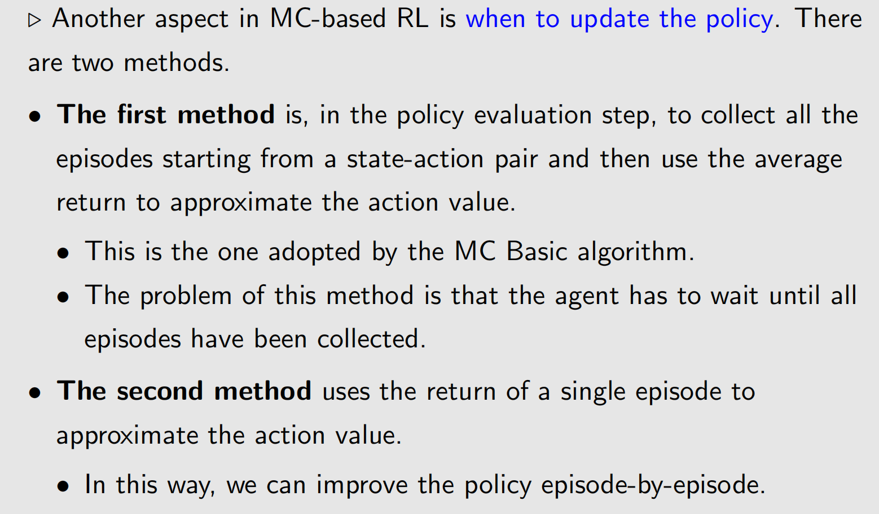
3. Use data more efficiently –MC Exploring Starts

Slide 28
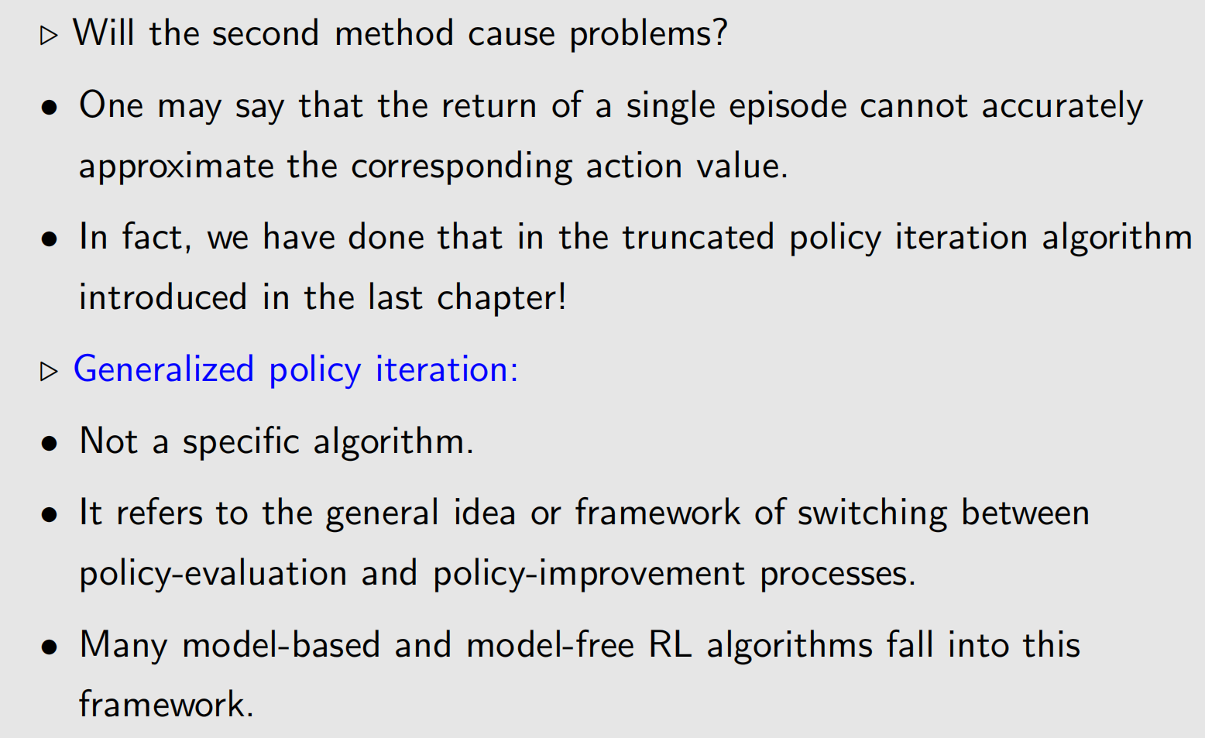
3. Use data more efficiently –MC Exploring Starts

Slide 29
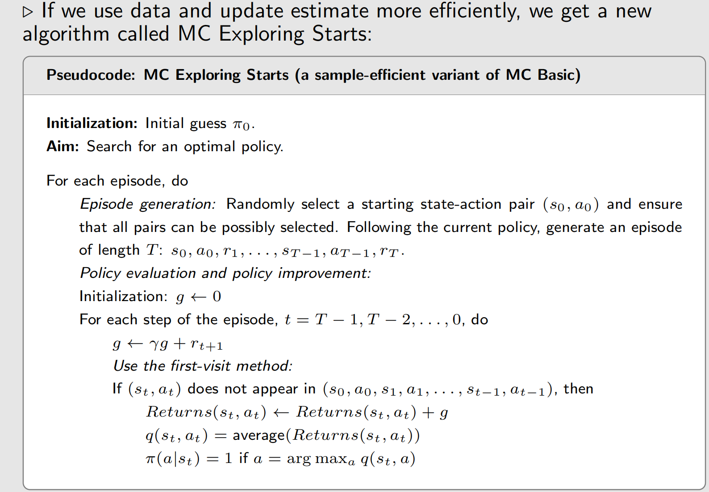
3. Use data more efficiently –MC Exploring Starts

Slide 30
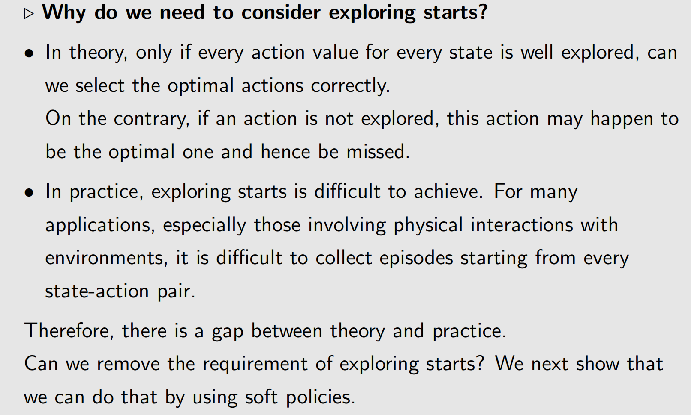
3. Use data more efficiently –MC Exploring Starts
Exploring starts 是指在强化学习中，要求从每一个状态-动作对（state-action pair）出发生成足够多的Episode。MC Basic 和 MC Exploring Starts 都需要这个假设。

Slide 31
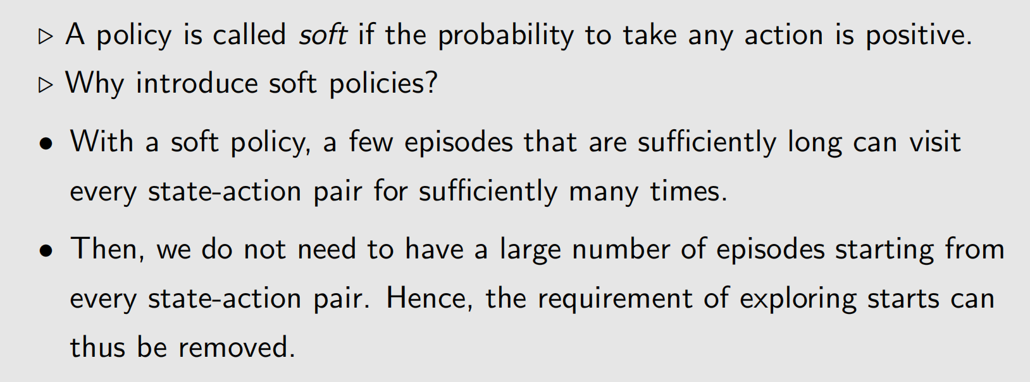
4. MC without Exploring Starts – MC ε-Greedy
Soft policies
智能体有可能采取每个可能的动作（即使概率很小）

Slide 32
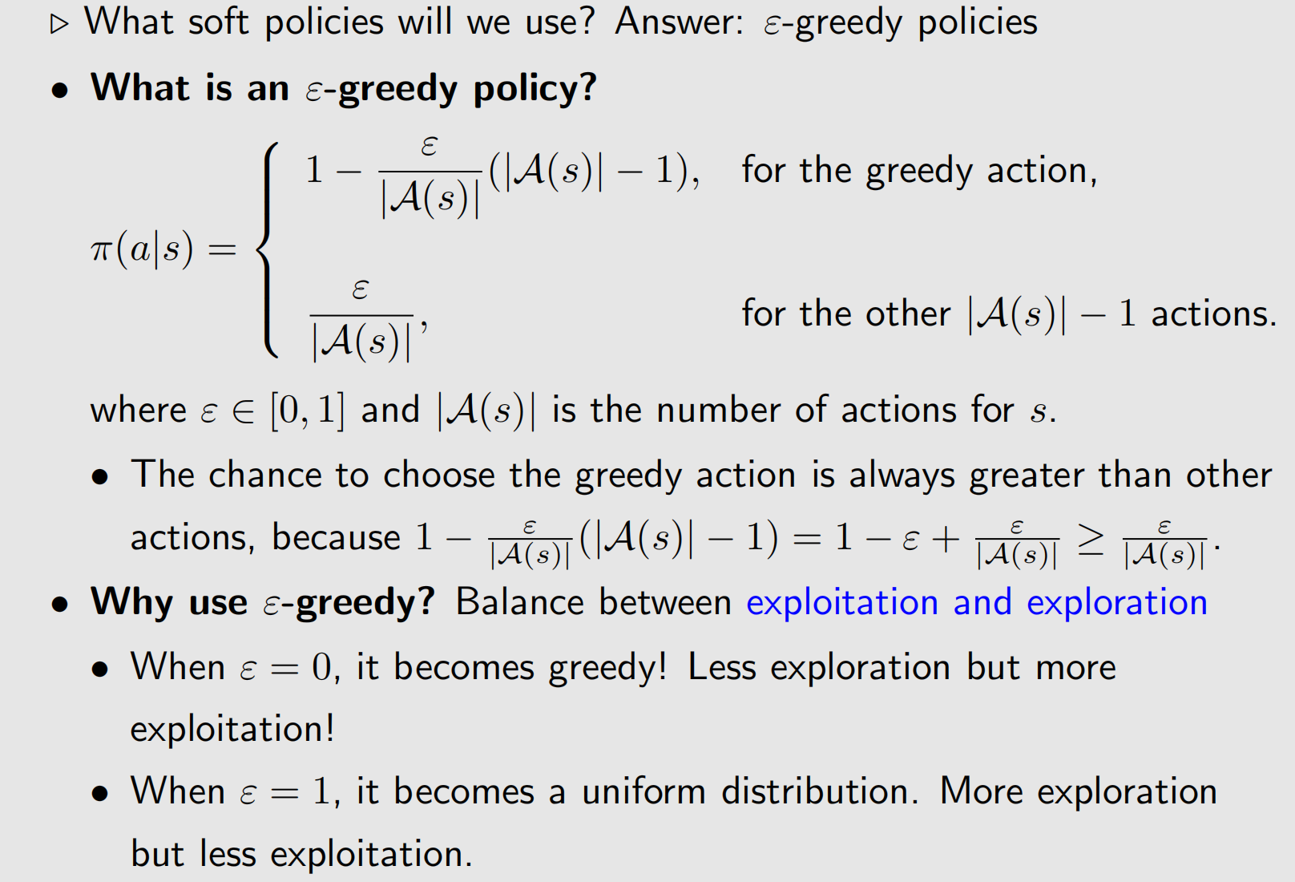
4. MC without Exploring Starts – MC ε-Greedy
ε-greedy policies

Slide 33
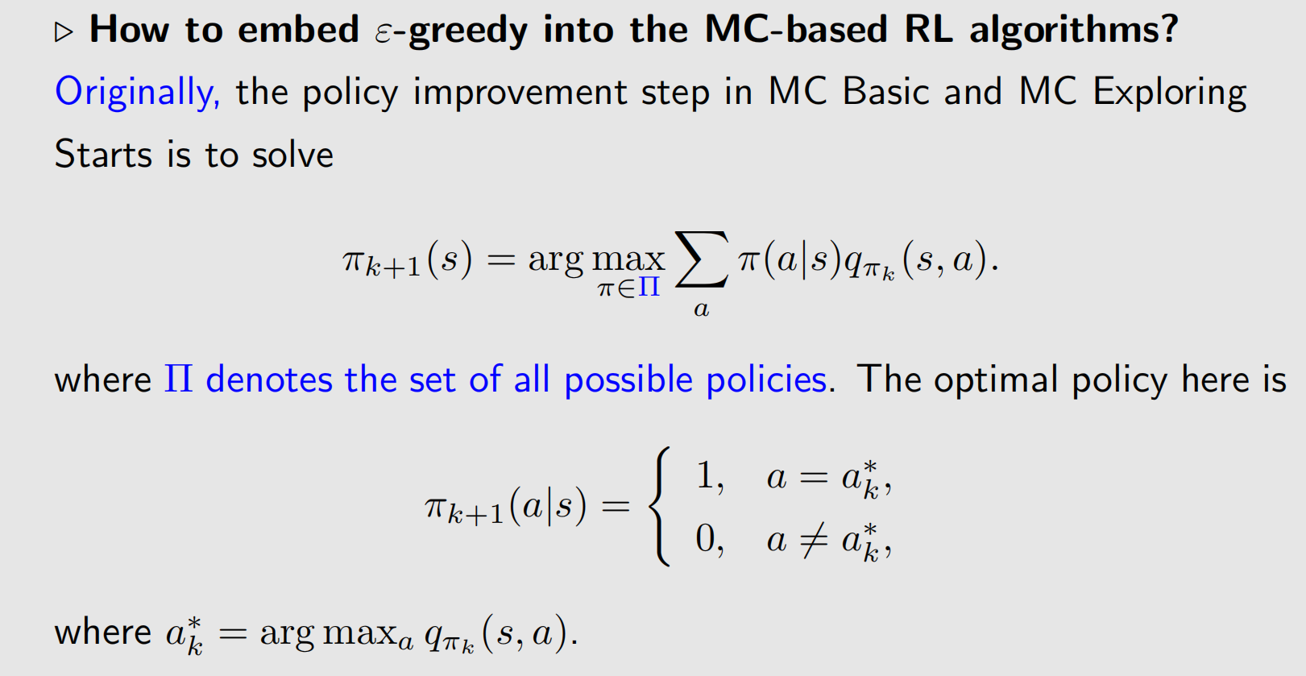
4. MC without Exploring Starts – MC ε-Greedy
ε-greedy policies

Slide 34
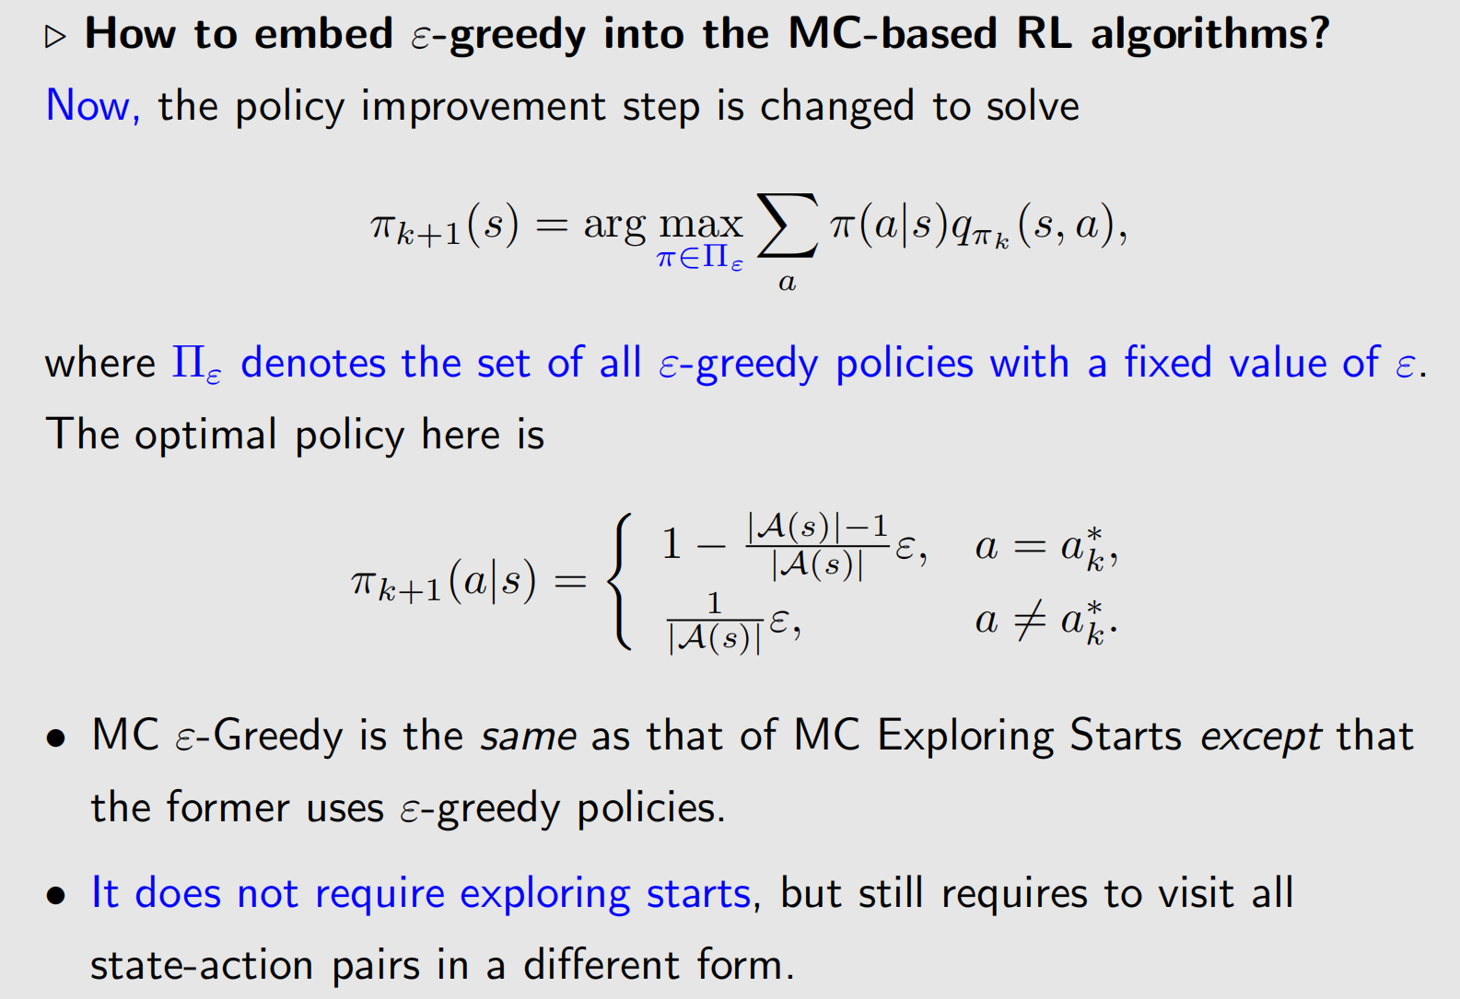
4. MC without Exploring Starts – MC ε-Greedy

Slide 35
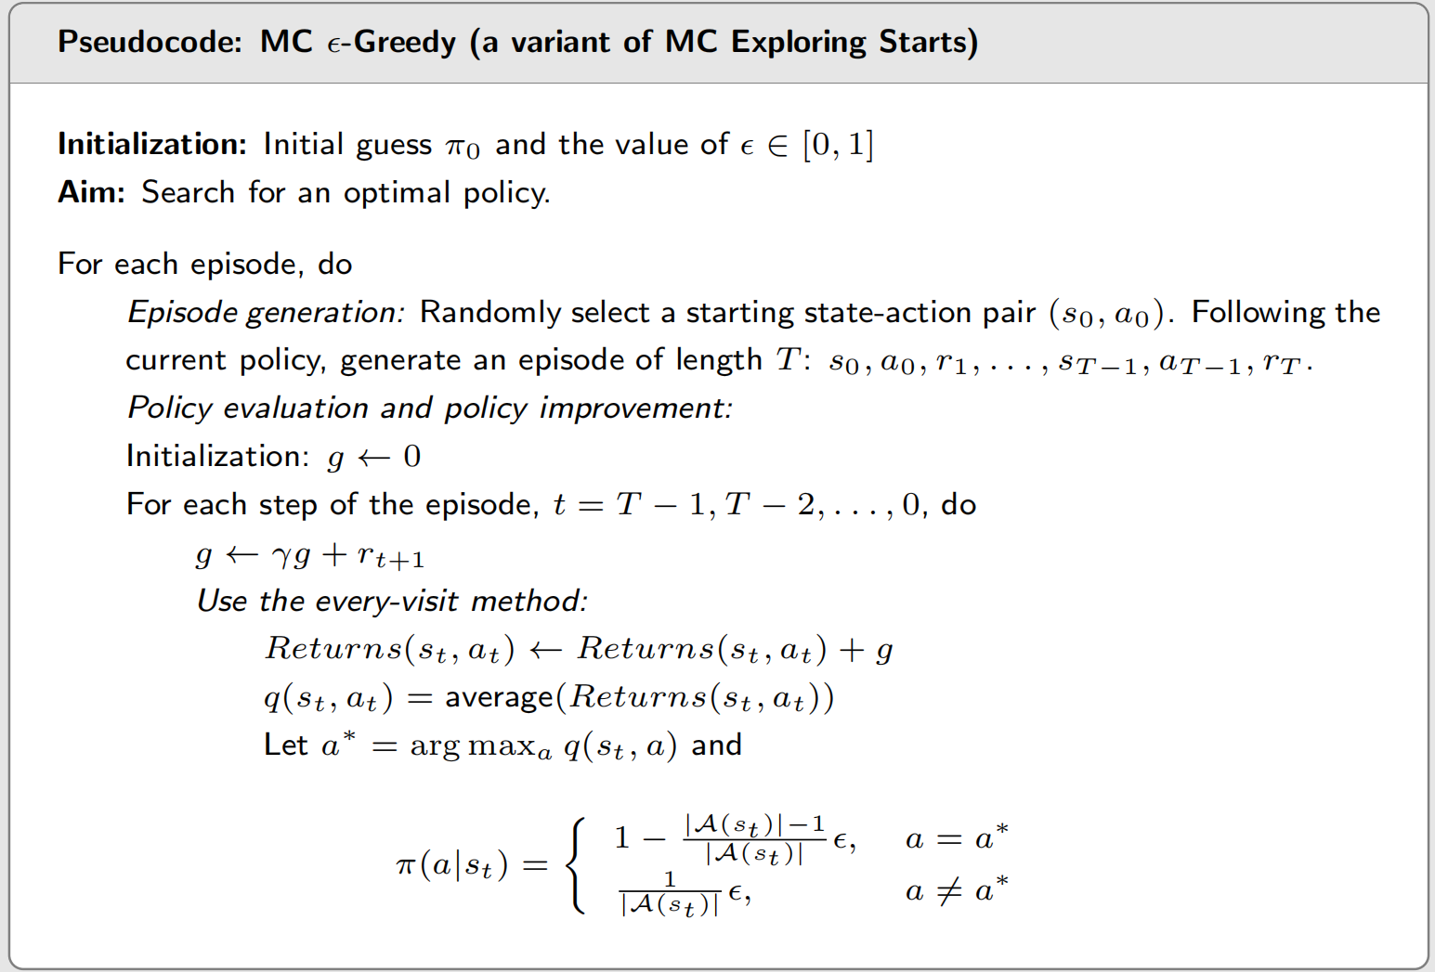
4. MC without Exploring Starts – MC ε-Greedy

Slide 36
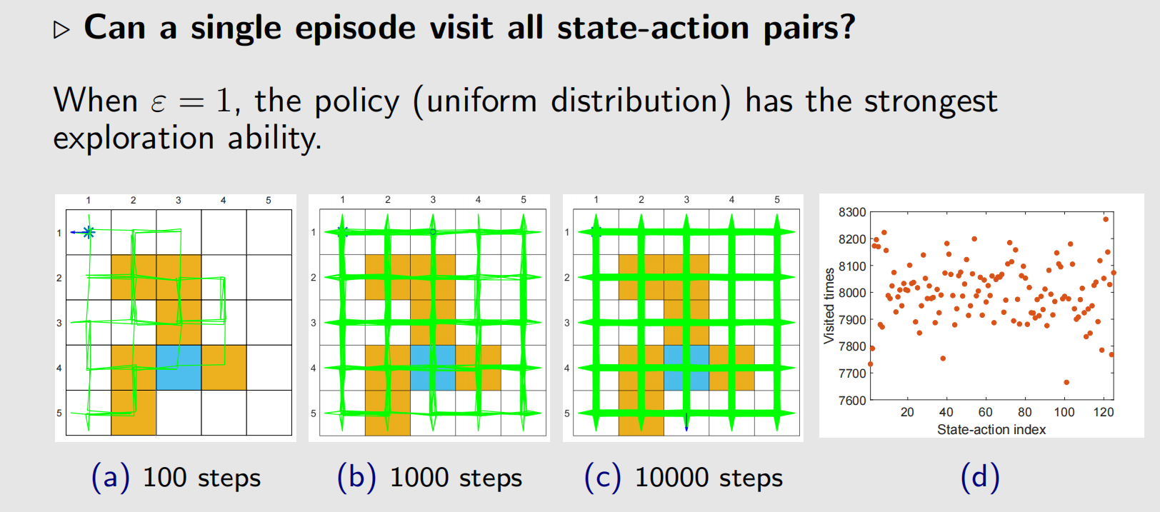
4. MC without Exploring Starts – MC ε-Greedy
Exploration ability

Slide 37
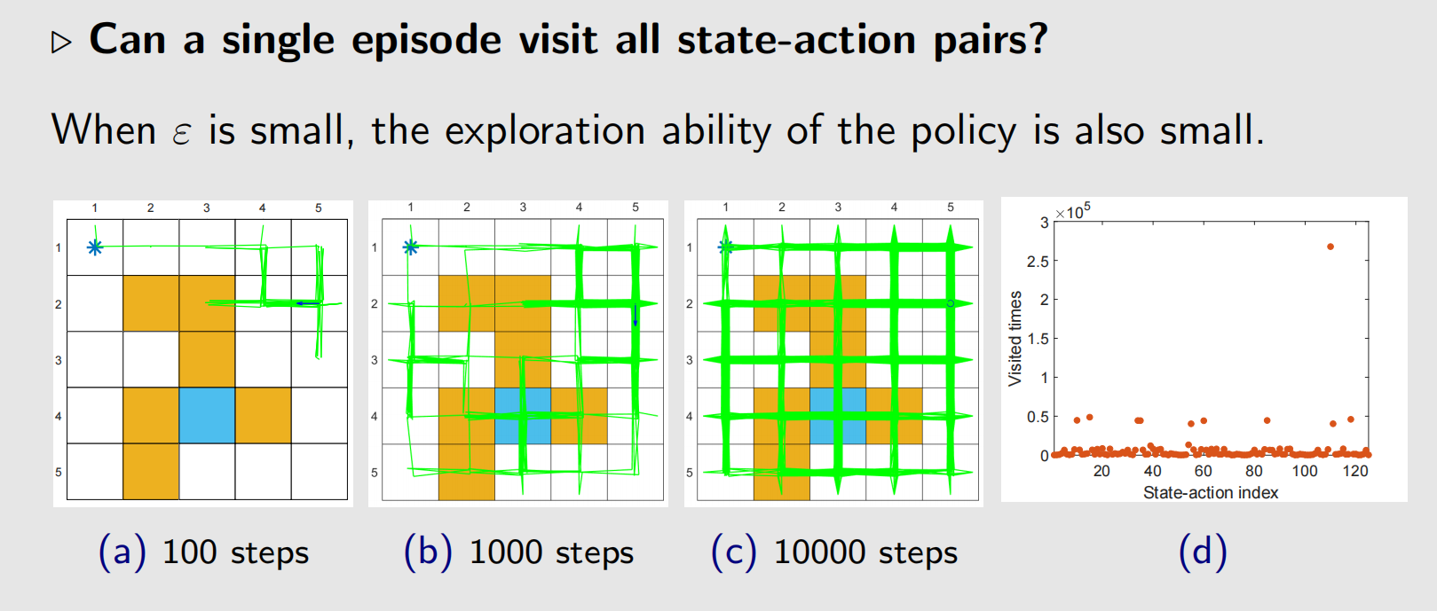
4. MC without Exploring Starts – MC ε-Greedy
Exploration ability

Slide 38

4. MC without Exploring Starts – MC ε-Greedy
Estimate based on one episode

Slide 39

4. MC without Exploring Starts – MC ε-Greedy
Optimality vs exploration

Slide 40

4. MC without Exploring Starts – MC ε-Greedy
Optimality vs exploration

Slide 41

4. MC without Exploring Starts – MC ε-Greedy
Consistency

Slide 42

Summary

